Slide 1

Project: Bike sales in Europe, Australia, and the USA
Tableau Presentation link

Slide 2
Introduction
Motivation
The project provides a comprehensive collection of sales data of the wide range of product categories split by region. My primary focus is to uncover valuable business insights and answer key questions that can drive strategic decisions for bike sales in these markets.
Objective
The objective of this project is to conduct an advanced exploratory analysis in Python, such as REGRESSION and CLUSTER analysis. This analysis will identify key factors influencing PROFIT.
Scope
Exploring relationships in Python, using a correlation matrix.
Performing comparative analysis of different variables.

Slide 3
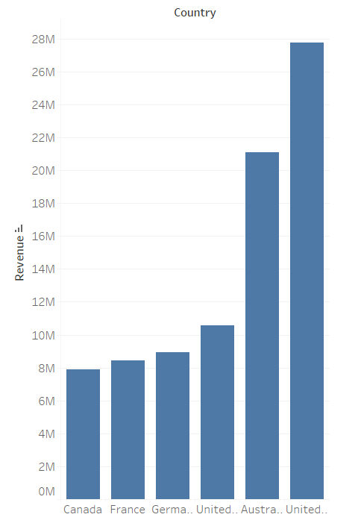
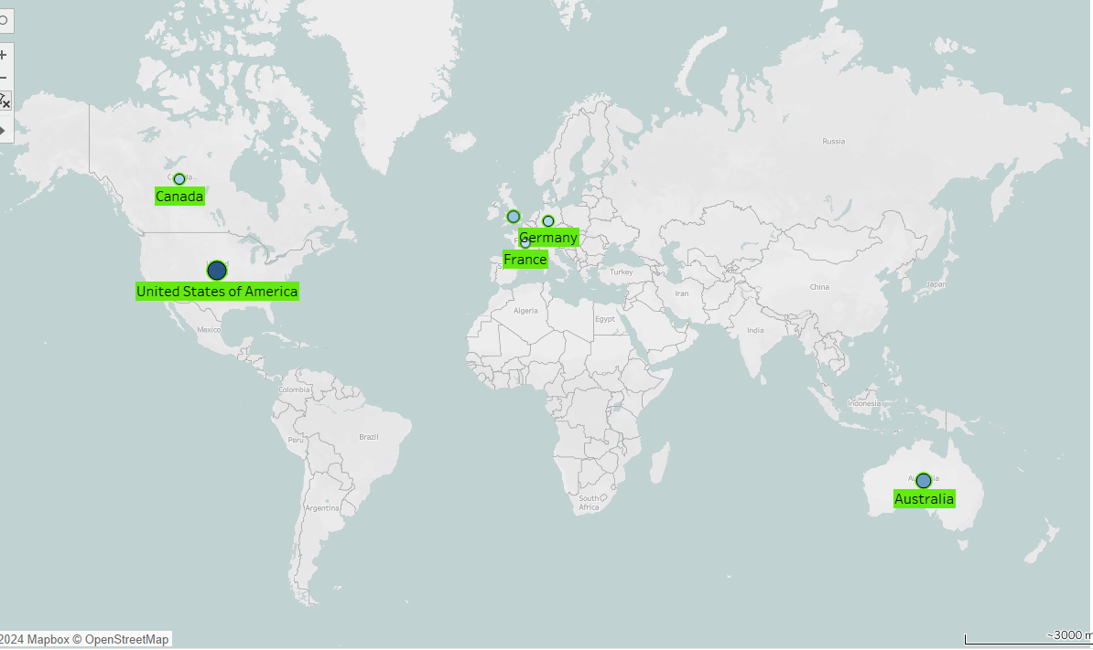
How Revenue distributed by countries

Slide 4
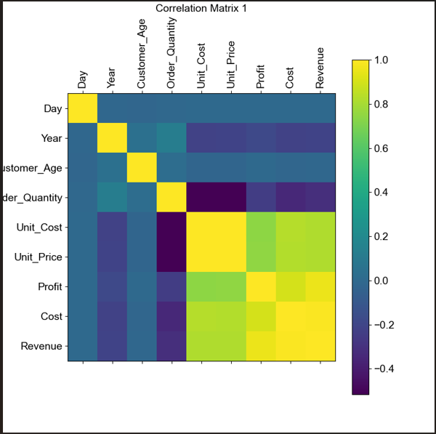
Correlation Matrix 1 shows relations between variables. The color bar next to the plot indicates weak and strong Correlation. 1 (one) is the strong Correlation and it goes down until 0 (zero) where the least Correlation is.
Correlation Matrix 1

Slide 5

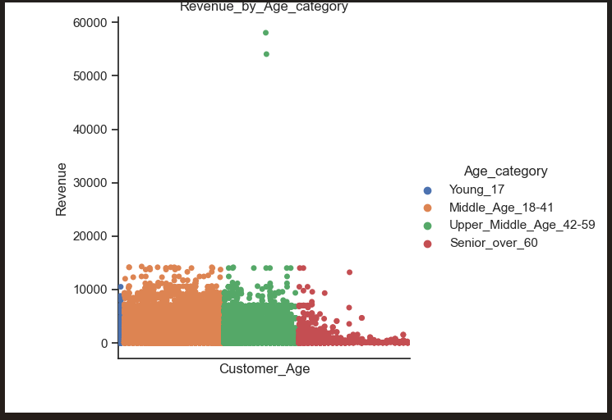
“QUOTE”
Revenue by Age category
The Young Group represented by a small group of people. Group has relatively small impact to the Revenue.
The Middle Age Group has the most Impact and high density. It brings the most of Revenue.
Upper_Middle_Age Group a little bit less, but still brings the Revenue but with less density of people age, as the Middle_Age Group.
Senior Group has less density and Revenue. The tendency has to become drastically low.

Slide 6
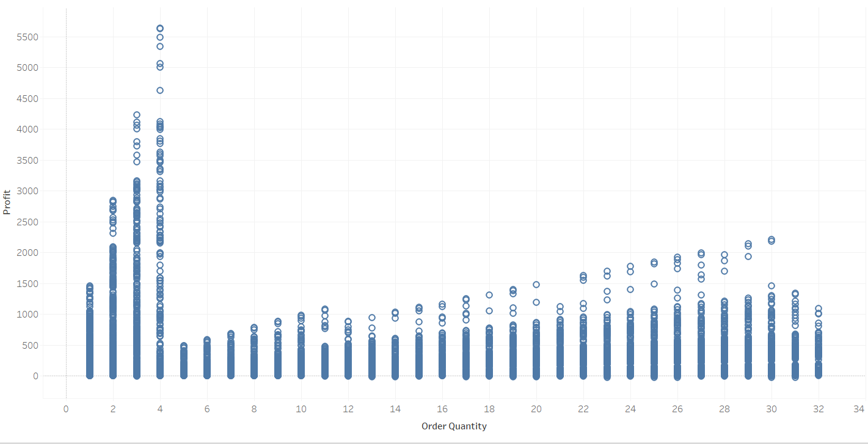
Regression analysis
The chart shows linear regression of two variables: Order Quantity and Profit where the first is independent and the second is dependent variables.
The biggest insight here is that the Profit does not rely on Order Quantity but on other factors…probably the Price of the product.

Slide 7
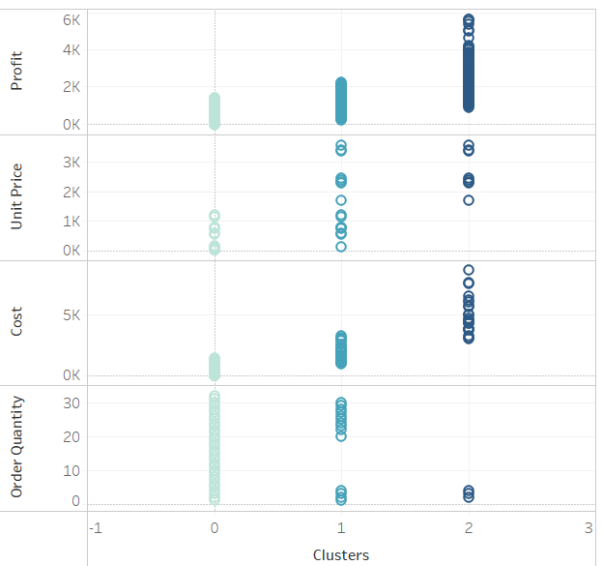
Cluster analysis
The plot shows how the Profit (dependent variable) relies on cost, order quantity, and unit price.
Zero cluster (0) shows high order quantity but low Profit.
First (1) shows a relatively temperate Unit Price but also not a high Profit.
The second (2) cluster shows that Profit could be high even if the Order quantity is low. Here the costs are high and the unit price is higher than in Cluster 0 and 1

Slide 8
Conclusion
High costs often indicate inefficiencies or higher expenses that cut into profit margins. However, the previous plot shows us the opposite tendency.
This analysis answering the question: while cost of product has a huge impact on Profit we should consider all factors in terms of getting more Profit . This analysis answering the question: while cost of product has a huge impact on Profit we should consider all factors in terms of getting more Profit . This analysis answering the question: while cost of product has a huge impact on Profit we should consider all factors in terms of getting more Profit . This analysis answering the question: while cost of product has a huge impact on Profit we should consider all factors in terms of getting more Profit .
In this Project, Profit is not influenced by order quantity. Instead, unit price has a minor effect, while Cost has the most significant impact.
This analysis answering the question: while cost of product has a huge impact on Profit we should consider all factors in terms of getting more Interest .

